Slide 1
Statistical and Predictive Modeling 2
Final project Name: Paramvir singh Bali Student number: 100843502

Slide 2
Rational statement
In the given dataset there are 3,333 observation and 11 variables .
I will create leraning curve for logistic and naïve bayes algorithm to check whether the model is good fit, underfit and overfit.
Further I will Create Optimize models (including ROC/AUC Curves) using the logistics and naïve bayes
I will create and present Ensemble voting model and then compare it with logistics and naïve bayes model.
Finally, I will recommend best model to mr john hughes.

Slide 3
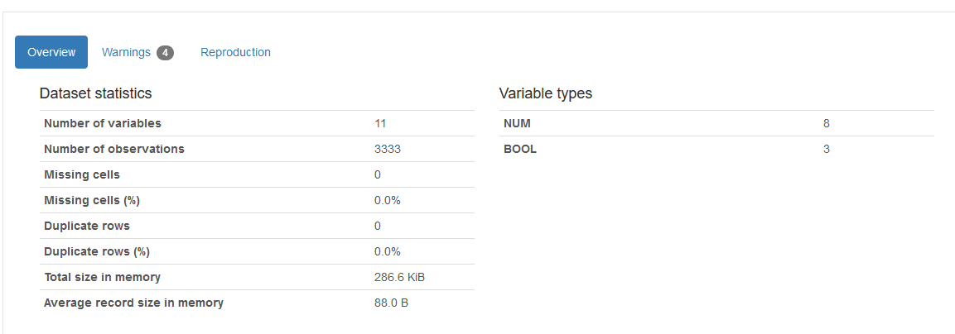
Three key Insight from pandas profile report
Overview from the pandas profile:
overview generally give us the basic description of the dataset.
There are 11 columns,3333 rows,0 missing values and 18 duplicate rows.286.6 kb is the size of the dataset in memory and 88.0 Byte is the size which every row occupies
There are three types of variables/column namely numeric, categorical and boolean in which 8 are numeric column, 3 are the boolean column.

Slide 4
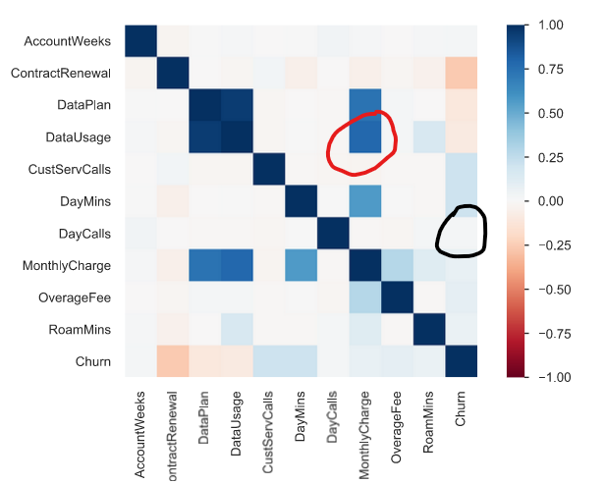
Three key Insight from pandas profile report
Correlations from pandas profile using heat map :
correlations is used for bivariate analysis between two variables.The dark blue color indicates that they are highly correlated and red coler indicates that they are very less correlated.
The variables monthly charge and datausage have a light blue color(I circle it with red) means that they are somehow highly correlated and dependent variable churn and independent daycalls have a white(I circle it with black) which means they are less correlated.

Slide 5
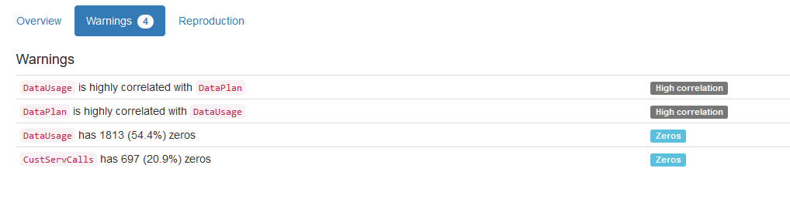
Three key Insight from pandas profile report
Warning from pandas profile:
We can analyse that there exist high multicollinearity between
independent variable datausage and dataplan. Thus it is very difficult for the regression model to determine the coefficients of these independent variables which makes the regression model little unstable.

Slide 6
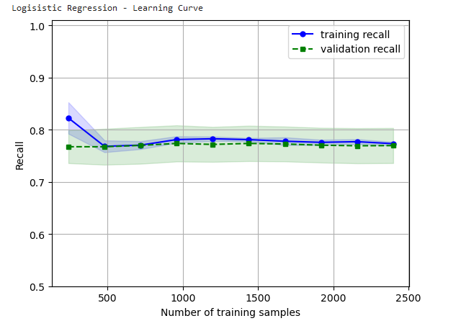
Presenting the learning curve and explaining the two key insight for logistic regresssion
Interpretating the training recall: Learning curve has high training recall which decreases slightly upon adding the training samples and further it flattens, indicating the addition of more training examples doesn’t improve the model performance on training the data.
Interpretating the validation recall: Learning curve has low validation recall than training recall which remains flatten, indicating the addition of more training smaples doesn’t improve the model performance on training the data.
Overall it is a good fit model because of the following reasons:
Training recall and validation recall are close to each other with training recall slightly greater than validation recall
We get a quite flat training and validation recall after some point.

Slide 7
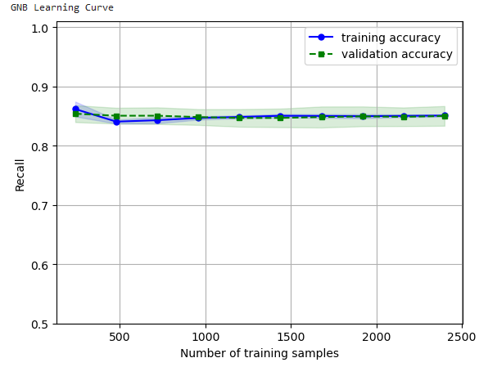
Presenting the learning curve and explaining the two key insight for naïve bayes
Interpretating the training recall: Learning curve has high training recall which decreases slightly upon adding the training samples and further it flattens, indicating the addition of more training examples doesn’t improve the model performance on training the data.
Interpretating the validation recall: Learning curve has low validation recall than training recall which remains flatten, indicating the addition of more training smaples doesn’t improve the model performance on training the data.
Overall it is a good fit model because of the following reasons:
Training recall and validation recall are close to each other with training recall slightly greater than validation recall
We get a quite flat training and validation recall after some point.

Slide 8

Presentation of the confusion metrics and classification report for the optimized logistic regression
Confusion matrix is N×N table(where N is the number of the classes) that contains number of incorrect and correct predictions of the classified model.
True negative: when both case and prediction is negative.Here 430 is the true negative means 430 times the model predicted clients subscribing for service out of 667 times correctly .
True positive: when both case and prediction is positive. Here 73 is the value of true positive means 73 times model predicted churning i.e. customers cancelling the service out of 667 times correctly.
False positive: when case is negative and prediction is positive.Here the value of false positive is 140. It means the 140 times the model is predicting churning(cancelling the service) wrongly however it is subscribing for services in reality.
False negative : when case is positive and prediction is negative. Here the value is 24. it means 24times the model is predicting that customers are subscribing the service wrongly however actually the customer cancelling the services.

Slide 9
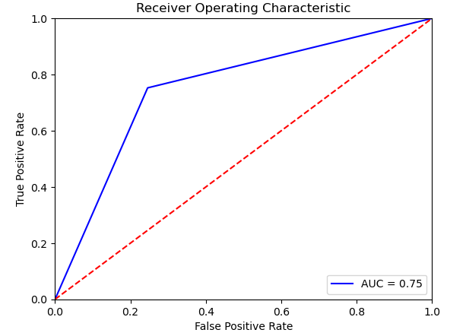
Presentation of the ROC curve for logistic regression model
Reciever operating characteristic is the graph between true positive values and false positive value
The value of area under the curve for this model is 0.75 which is quite good.
It means there is 75% chance that model will be able to distinguish between positive and negative class correctly. It means that 25% true positive are classified as negative wrongly and 25% true negative are classified as positive wrongly. 75% true positive and true negative are classified correctly.Overall, this model is 75% efficient to correctly distinguish between true positive and true negative

Slide 10
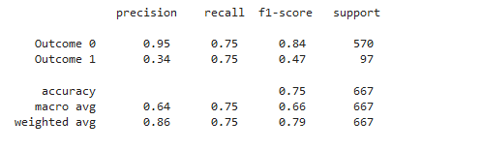
Three key insight(Precision,Recall and F1)of the optimized logistic regression
Precision means what proportion of predicted positives is truly positive.
Precision = truly positive/(truly positive +false negative)
The weighted average precision for this 86% efficient which is quite good. The value of the weighted average precision explains that only 86% of the predicted positive of this model are actually detected as true value and rest 14% predicted value are not actually detected as true positive.
Recall explain what proportion of actual positive is classified or detected.
Recall = true positive/ (true positive+false positive)
The weighted average recall for this model is 75% efficient which is quite high. The value of the weighted average recall explain that only 75% of actual positive is detected and rest 25% predicted value are not actual positive.
F1 score is the harmonic mean of precision and Recall. It is the combination of precision and Recall.
We use F1 score because there is always a trade off between Recall and precision ie if we train our model to increase precision then Recall will decrease and vice versa.
The weighted average F1 score for SVM algorithm is 79% efficient which is quite high

Slide 11

Presentation of the confusion metrics and classification report for the optimized naïve bayes
Confusion matrix is N×N table(where N is the number of the classes) that contains number of incorrect and correct predictions of the classified model.
True negative: when both case and prediction is negative.Here 520 is the true negative means 520 times the model predicted clients subscribing for service out of 667 times correctly
True positive: when both case and prediction is positive. Here 40 is the value of true positive means 40 times model predicted churning i.e. customers cancelling the service out of 667 times correctly.
False positive: when case is negative and prediction is positive.Here the value of false positive is 50. It means the 50 times the model is predicting churning(cancelling the service) wrongly however customer are subscribing for services in reality.
False negative : when case is positive and prediction is negative. Here the value is 57. it means 57 times the model is predicting that customers are subscribing the service wrongly however actually the customer cancelling the services.

Slide 12
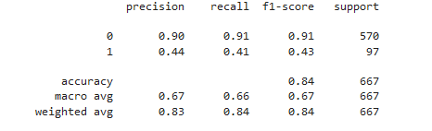
Three key insight(Precision,Recall and F1)of the optimized naïve bayes
Precision means what proportion of predicted positives is truly positive.
Precision = truly positive/(truly positive +false negative)
The weighted average precision for this 83% efficient which is quite good. The value of the weighted average precision explains that only 83% of the predicted positive of this model are actually detected as true value and rest 17% predicted value are not actually detected as true positive.
Recall explain what proportion of actual positive is classified or detected.
Recall = true positive/ (true positive+false positive)
The weighted average recall for this model is 84% efficient which is quite high. The value of the weighted average recall explain that only 84% of actual positive is detected and rest 16% predicted value are not actual positive.
F1 score is the harmonic mean of precision and Recall. It is the combination of precision and Recall.
We use F1 score because there is always a trade off between Recall and precision ie if we train our model to increase precision then Recall will decrease and vice versa.
The weighted average F1 score for SVM algorithm is 84% efficient which is quite high

Slide 13

Presentation of ensemble model result and comparision with optimized logistic and naïve bayes
The voting classifier has the precision of 84% which is greater than the logistic regression(76%) and bagging classifier(8%)
The voting classifier is a remarkable approach for classification because its methodology utilizes the collective judgment of multiple classifiers(logistic regression and bagging classifier) for predicting final results.
The voting classifier(84%)performs less than logistic regression(86% precision) but however it performs more than naïve bayes(83% precision).

Slide 14
one model that should be implemented by mr john hughes
I will like to recommend voting modle/voting classifier to mr. john hughes because of the following reasons:
Voting is an ensemble method that combines the performances of multiple models to make predictions.
In voting model,voting relies on the performance of many models, they will not be hindered by large errors or misclassifications from one model. A poor performance from one model can be offset by a strong performance from other models for example in voting model that I created has 8% precision/accuracy in case bagging classifier which is very poor but however voting model offset this poor performance.

Slide 15
References
Week3 - Data2204-Overview-CM
https://towardsdatascience.com/learning-curve-to-identify-overfitting-underfitting-problems-133177f38df5
An introduction to statistical learning-springer texts in statics E book
Week 8,9,12 – data2204-overview-cm

